Slide 1
Amazon Elastic Cloud Computing (Amazon EC2)

Slide 2
Amazon Elastic Compute Cloud (Amazon EC2)
Amazon Elastic Compute Cloud (Amazon EC2) provides scalable computing capacity in the Amazon Web Services (AWS) cloud.
You can use Amazon EC2 to launch as many or as few virtual servers as you need, configure security and networking, and manage storage.
Amazon EC2 enables you to scale up or down to handle changes in requirements or spikes in popularity, reducing your need to forecast traffic.

Slide 3
Features of Amazon EC2
Virtual computing environments, known as instances
Preconfigured templates for your instances, known as Amazon Machine Images (AMIs), that package the bits you need for your server (including the operating system and additional software)
Various configurations of CPU, memory, storage, and networking capacity for your instances, known as instance types
Secure login information for your instances using key pairs (AWS stores the public key, and you store the private key in a secure place)

Slide 4
Features of Amazon EC2
Persistent storage volumes for your data using Amazon Elastic Block Store (Amazon EBS), known as Amazon EBS volumes
Multiple physical locations for your resources, such as instances and Amazon EBS volumes, known as Regions and Availability Zones
A firewall that enables you to specify the protocols, ports, and source IP ranges that can reach your instances using security groups

Slide 5
Features of Amazon EC2
Storage volumes for temporary data that's deleted when you stop or terminate your instance, known as instance store volumes
Static IPv4 addresses for dynamic cloud computing, known as Elastic IP addresses
Metadata, known as tags, that you can create and assign to your Amazon EC2 resources

Slide 6
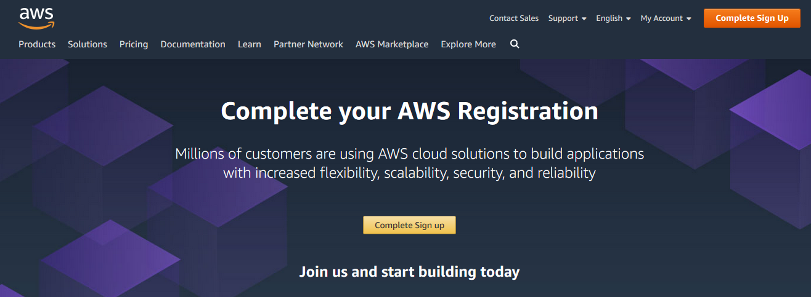
Aws account create(https://aws.amazon.com)

Slide 8
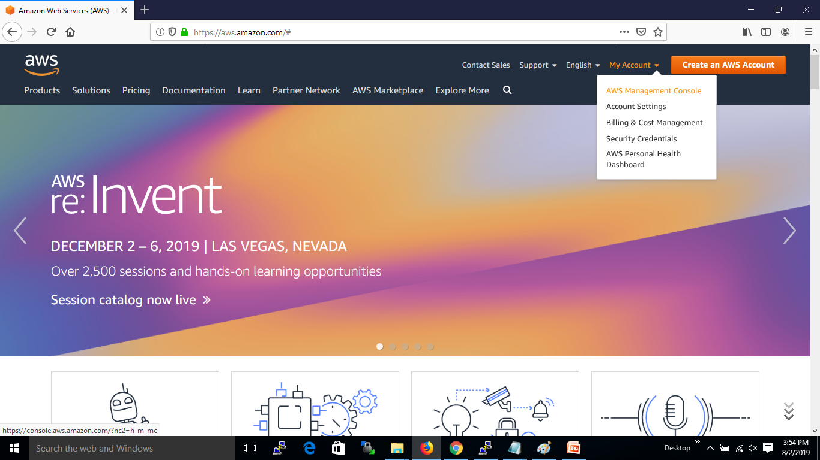
AWS Management Console

Slide 9
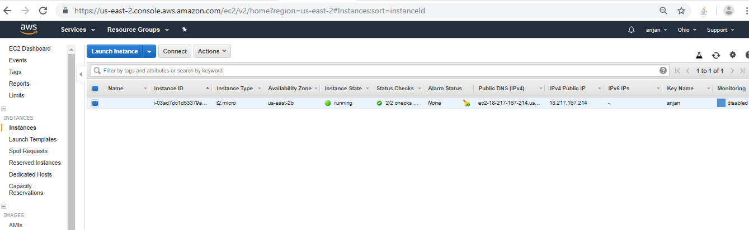
EC2 Instance

Slide 10
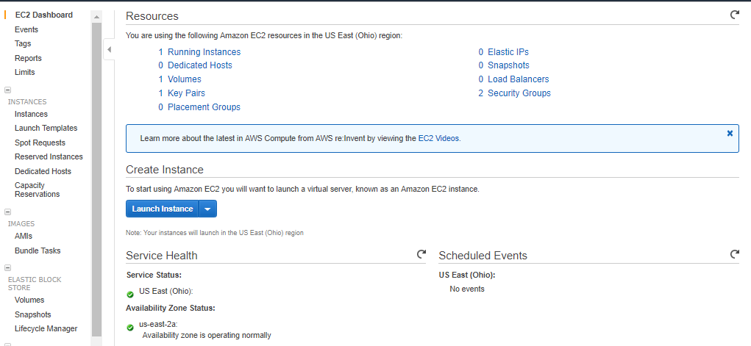
EC2 Dashboard

Slide 11
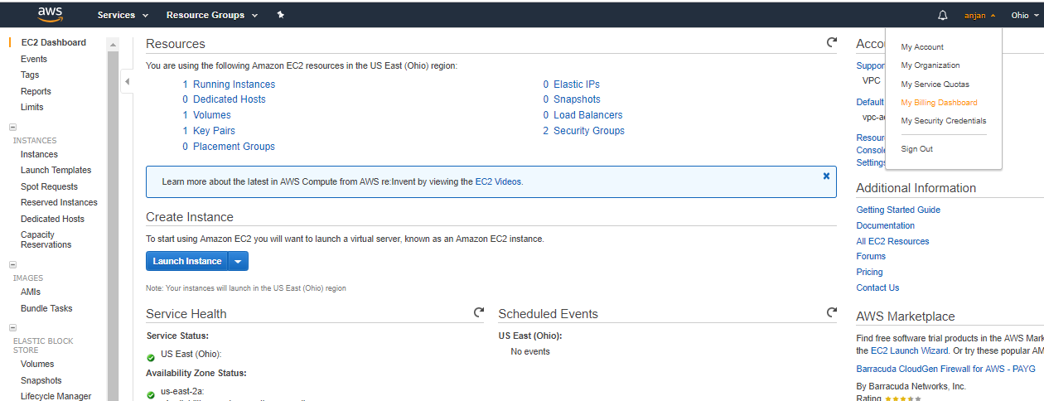
Billing Information

Slide 12
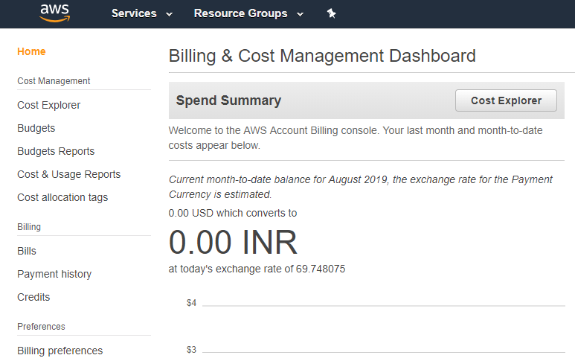

Slide 13
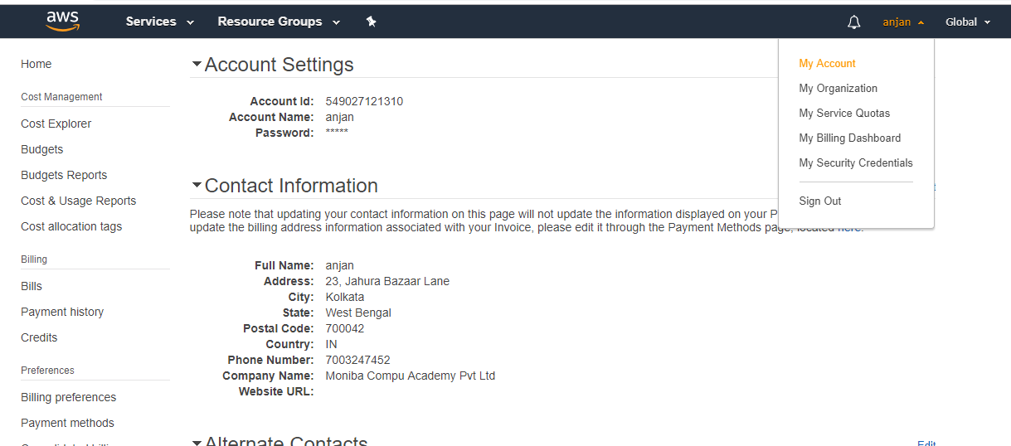
Account Information

Slide 14
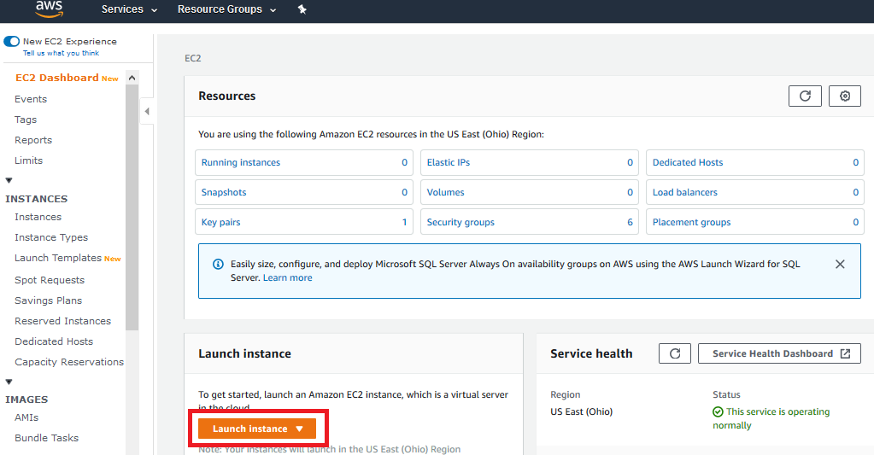
Create a EC2 Instance

Slide 15
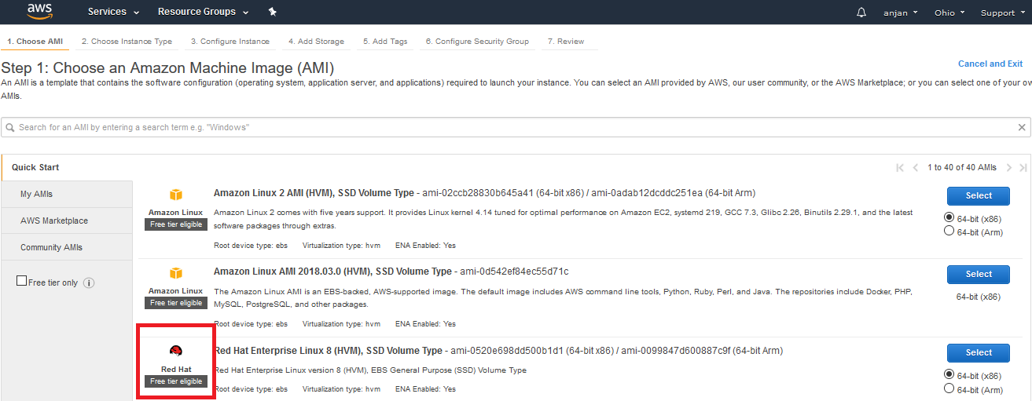
Select the Image

Slide 16
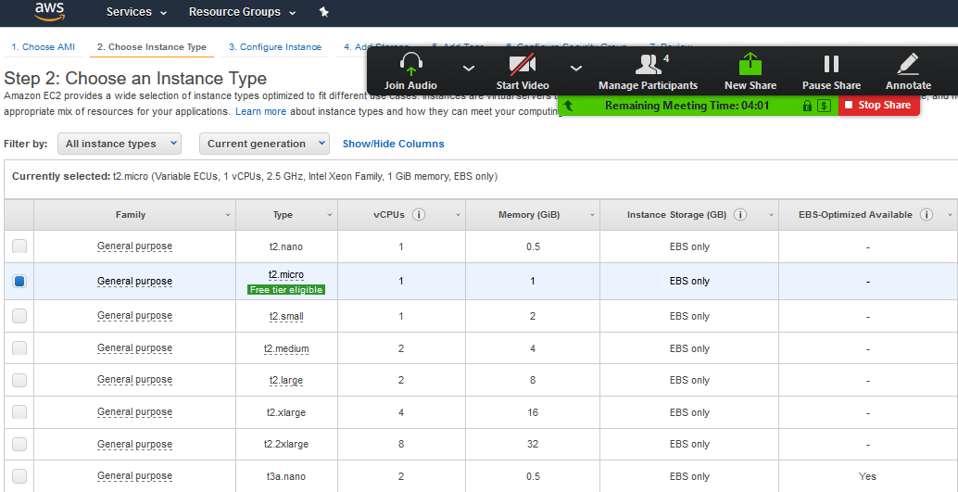
Select t2.micro

Slide 17
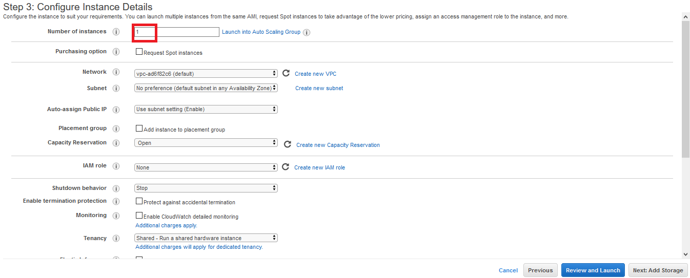
More Configuration

Slide 18
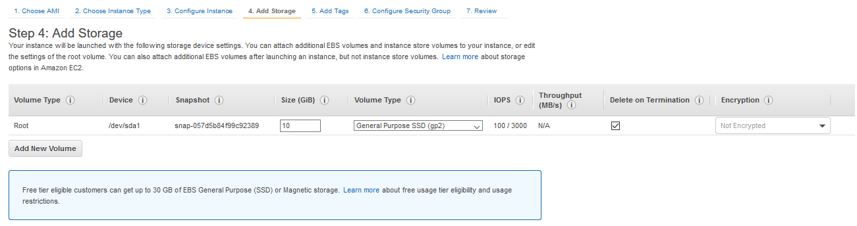
Storage to EC2

Slide 19
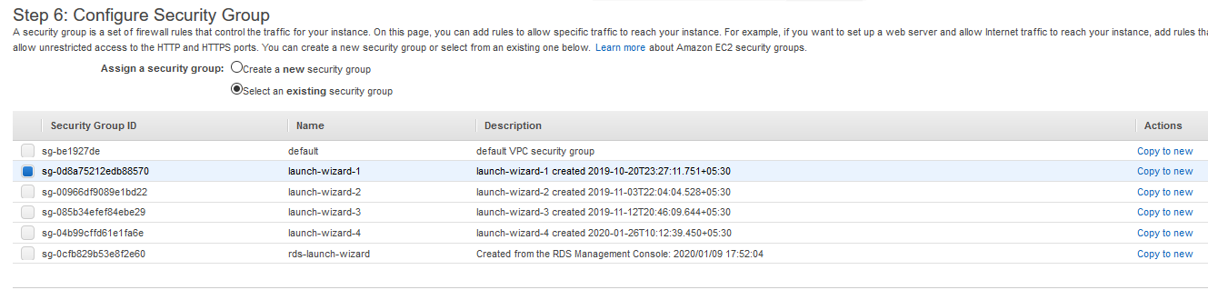
Configure Security Group

Slide 20
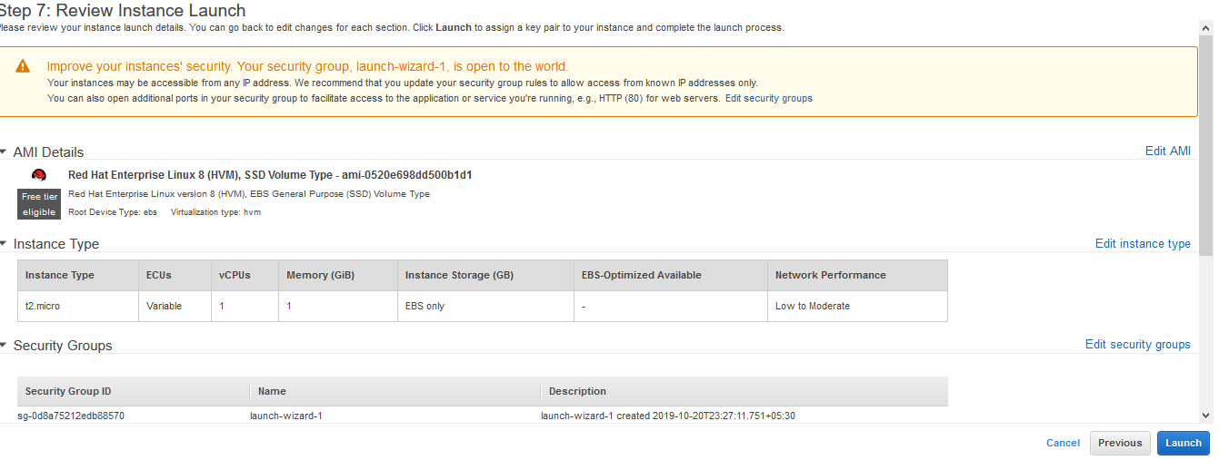
Launch

Slide 21
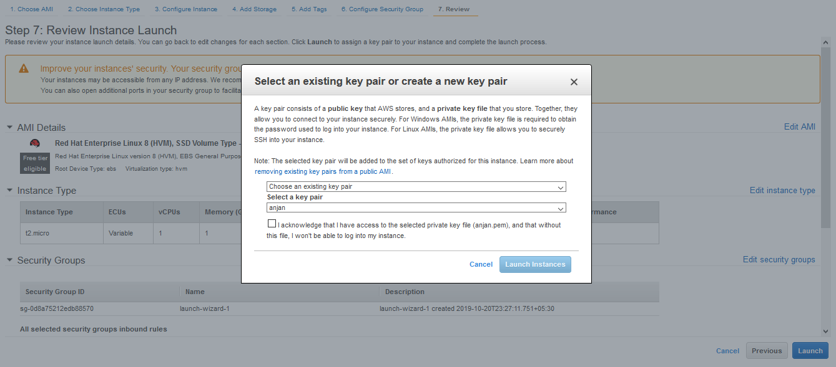
Security Key

Slide 22
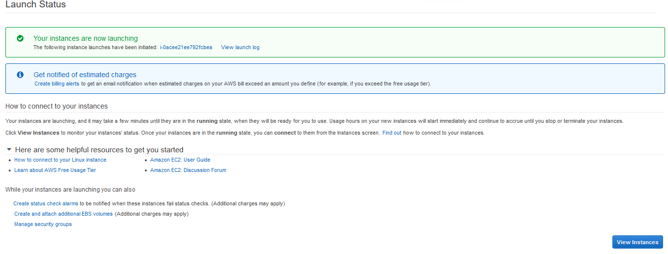
Instance Launching

Slide 23
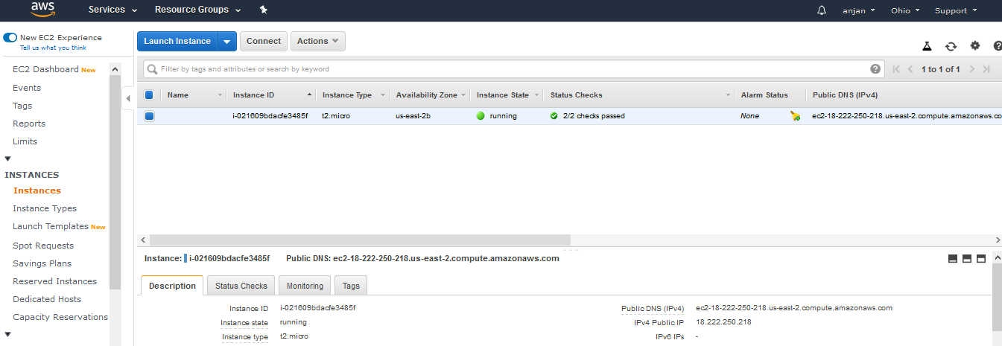
Instance created and Running

Slide 24
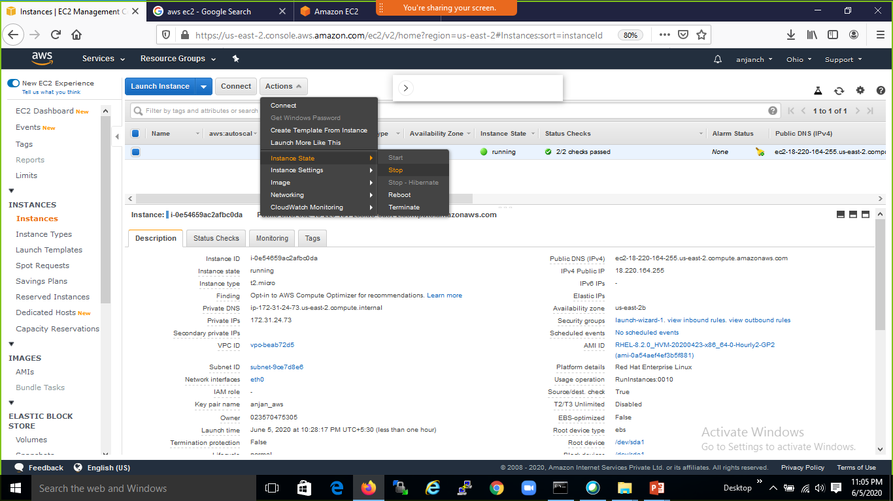

Slide 25
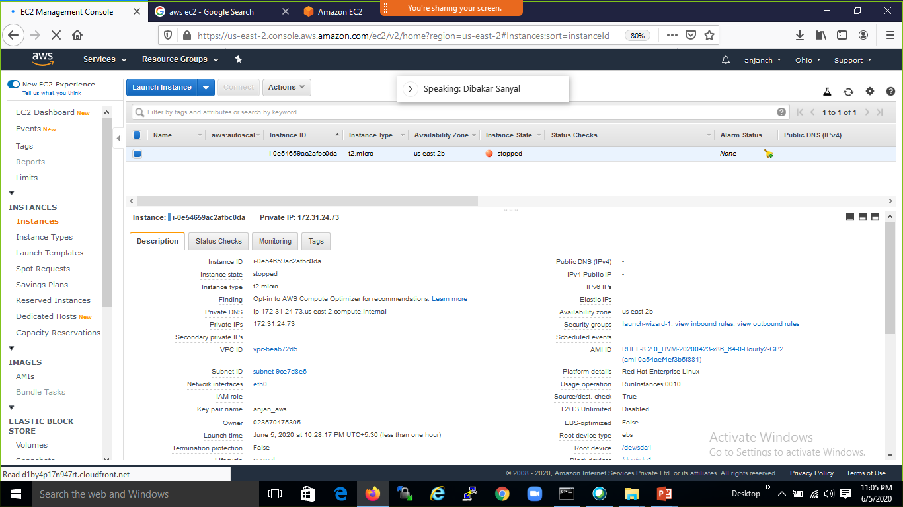

Slide 26
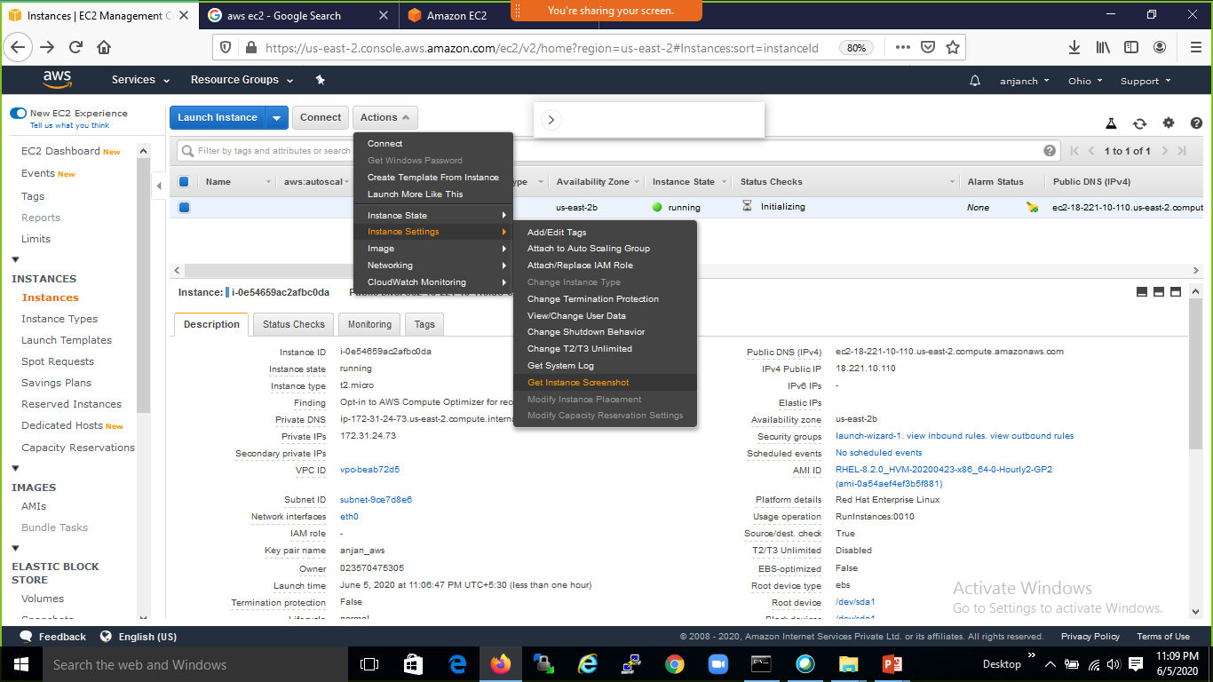

Slide 27
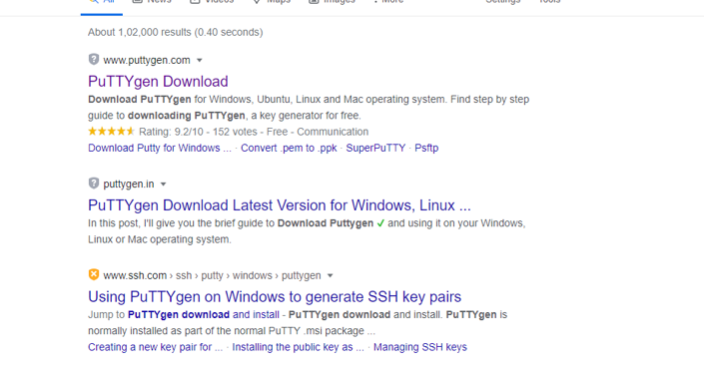

Slide 28
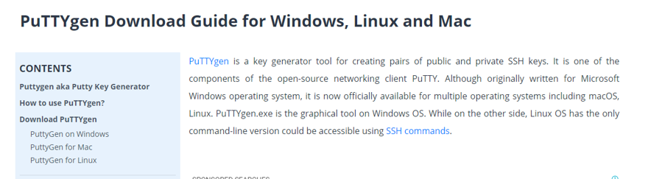

Slide 29
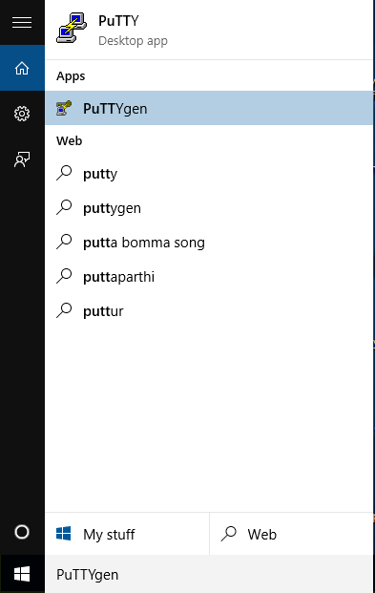

Slide 30
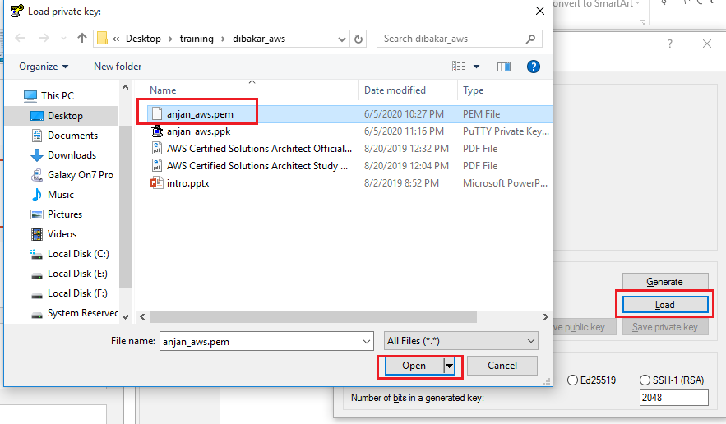

Slide 31
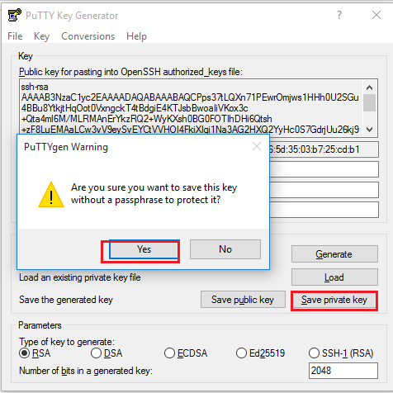

Slide 32
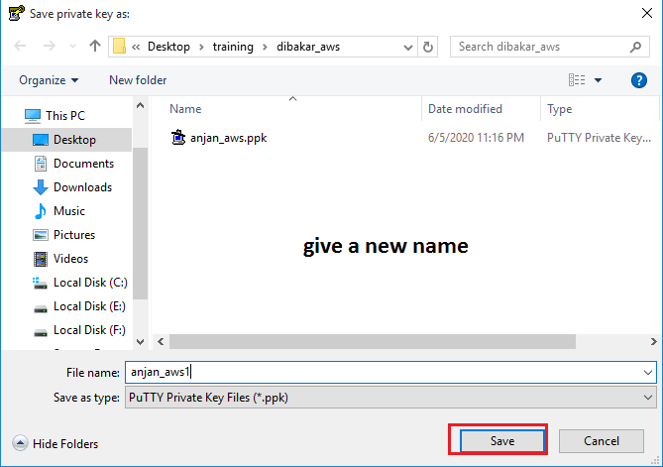

Slide 33
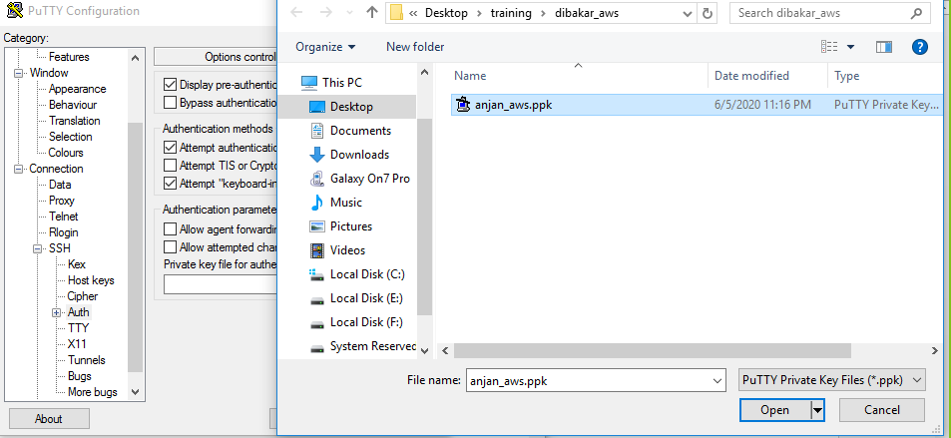

Slide 34
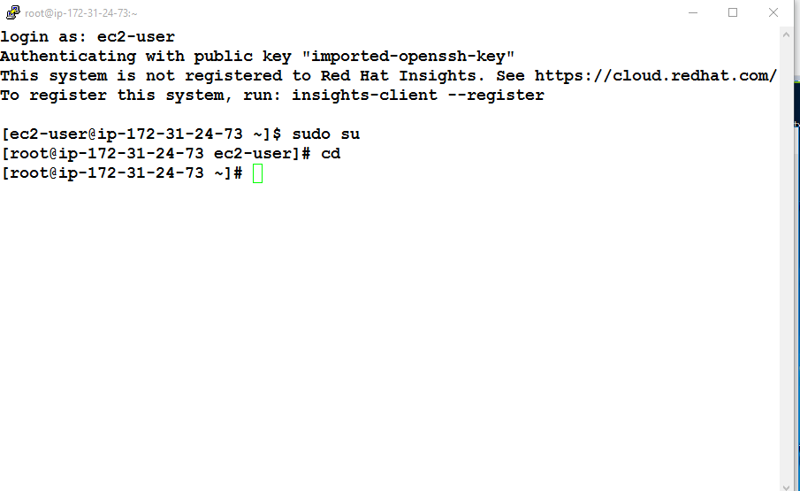

Slide 36
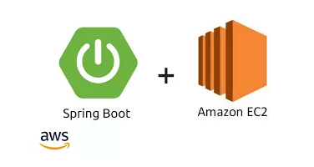
deploy a Spring Boot Application on AWS EC2 instance
1. Create a Spring Boot Project with Spring Boot Initialiser. 2. Create a Rest end Point,which we can access after deployment 3. Launch an EC2 instance 4. Copy our Spring Boot project from our local machine to EC2 instance 5. Connect to EC2 instance using SSH 6. Remove JDK 7 and install JDK 8 over EC2 instance
7. Execute the spring boot jar on EC2 instance 8. Make sure your Security group allows the inbound traffic from internet over port 8080 and using TCP protocol 9. Test the Application by hitting the endpoint URL from browser .
sudo yum install java-1.8.0-openjdk-devel

Slide 37
deploy a Spring Boot Application on AWS EC2 instance
Create a Spring Boot Project with Spring Boot Initialiser
@RestController
@RequestMapping(value = "/api")
public class Hello {
@GetMapping(value = "/v1/data")
public String sayHelloWorld() {
return "Hello JavaSolutionsGuide Readers";
}
}

Slide 38
deploy a Spring Boot Application on AWS EC2 instance
Launch an EC2 instance
copying code from your local machine to EC2 instance using tool like winscp or command scp as follows:
scp -i <path to pem file on local machine> <path to spring boot project or your deliverables> user@remote host name : ~

Slide 39
deploy a Spring Boot Application on AWS EC2 instance
Connect to EC2 instance using SSH
Remove JDK 7 (if present) in EC2 , then install JDK 8 over EC2 instance.
Command to remove JDK 7
sudo yum remove java-1.7.0-openjdk
Command to Install JDK 8
sudo yum install java-1.8.0
Execute the spring boot jar on EC2 instance
Execute following command
java -jar springbootproject-0.0.1-SNAPSHOT.jar

Slide 40

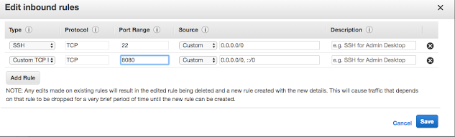
deploy a Spring Boot Application on AWS EC2 instance
Make sure your Security group allows the inbound traffic from internet over port 8080 and using TCP protocol
Click on the instance in AWS console and check the security group associated with your instance
Now,open this security group which shows that allows traffic from internet over port 22 only using SSH. Add port 8080 also as :
Test the Application by hitting the endpoint URL from browser

